Slide 1



Slide 2
Chapter 4 – Combinational Logic Circuits

Slide 3
Chapter 4 Objectives
Selected areas covered in this chapter:
Converting logic expressions to sum-of-products expressions.
Boolean algebra and the Karnaugh map as tools to simplify and design logic circuits.
Operation of exclusive-OR & exclusive-NOR circuits.
Designing simple logic circuits without a truth table.
Basic characteristics of TTL and CMOS digital ICs.
Basic troubleshooting rules of digital systems.
Programmable logic device (PLD) fundamentals.
Hierarchical design methods.
Logic circuits using HDL control structures IF/ELSE, IF/ELSIF, and CASE.
Digital Systems: Principles and Applications, 11/e
Ronald J. Tocci, Neal S. Widmer, Gregory L. Moss

Slide 4
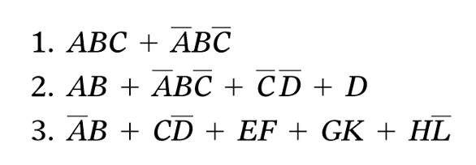
4-1 Sum-of-Products Form
A Sum-of-products (SOP) expression will appear as two or more AND terms ORed together.
Digital Systems: Principles and Applications, 11/e
Ronald J. Tocci, Neal S. Widmer, Gregory L. Moss

Slide 5
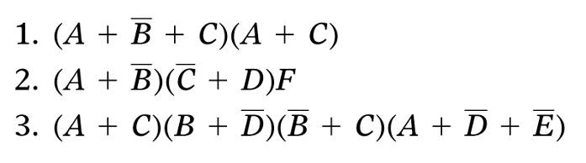
4-1 product-of-sums (POS) Form
The product-of-sums (POS) form consists of two or more OR terms (sums) ANDed together.
Digital Systems: Principles and Applications, 11/e
Ronald J. Tocci, Neal S. Widmer, Gregory L. Moss

Slide 6
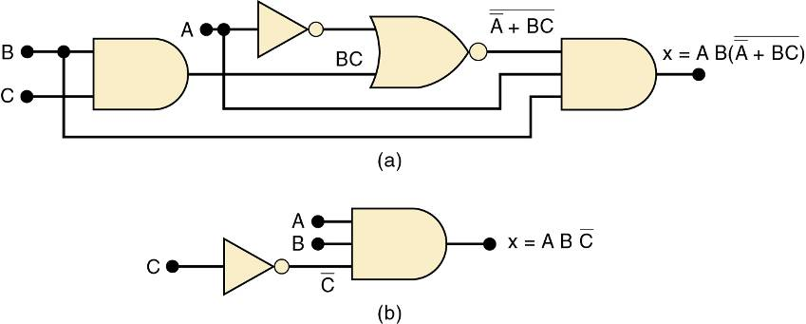
4-2 Simplifying Logic Circuits
The circuits shown provide the same output
Circuit (b) is clearly less complex.
Logic circuits can be simplified using Boolean algebra and Karnaugh mapping.
Digital Systems: Principles and Applications, 11/e
Ronald J. Tocci, Neal S. Widmer, Gregory L. Moss

Slide 7
4-3 Algebraic Simplification
Place the expression in SOP form by applying DeMorgan’s theorems and multiplying terms.
Check the SOP form for common factors.
Factoring where possible should eliminate one or more terms.
Digital Systems: Principles and Applications, 11/e
Ronald J. Tocci, Neal S. Widmer, Gregory L. Moss

Slide 8
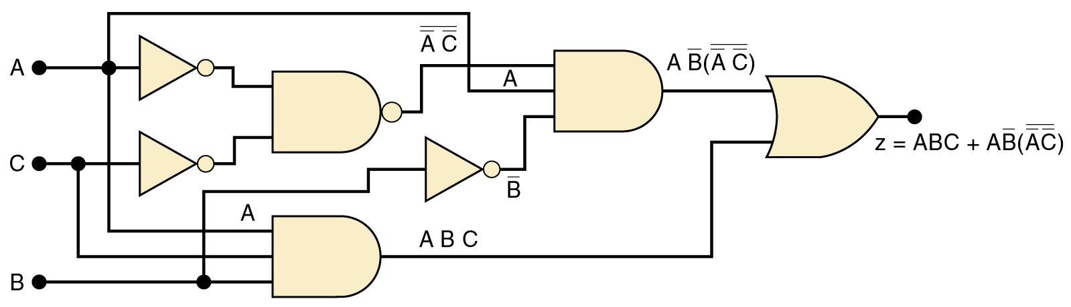
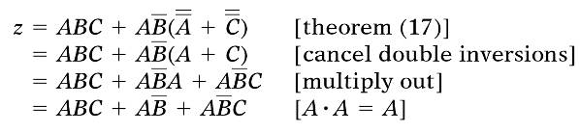
4-3 Algebraic Simplification
Simplify the logic circuit shown.
The first step is to determine the expression for the output:
z = ABC + AB • (A C)
Once the expression is determined, break down large inverter signs by DeMorgan’s theorems & multiply out all terms.
Digital Systems: Principles and Applications, 11/e
Ronald J. Tocci, Neal S. Widmer, Gregory L. Moss

Slide 9
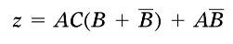
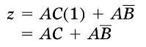
4-3 Algebraic Simplification
Simplify the logic circuit shown.
Factoring—the first & third terms above have AC in common, which can be factored out:
Since B + B = 1, then…
Factor out A, which results in…
Digital Systems: Principles and Applications, 11/e
Ronald J. Tocci, Neal S. Widmer, Gregory L. Moss

Slide 10
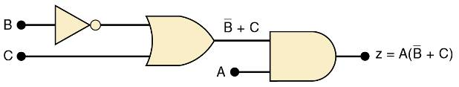
4-3 Algebraic Simplification
Simplifed logic circuit.
z = A(C + B)
Digital Systems: Principles and Applications, 11/e
Ronald J. Tocci, Neal S. Widmer, Gregory L. Moss

Slide 11
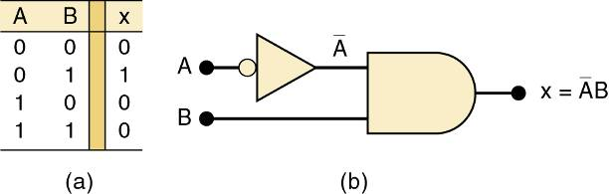
4-4 Designing Combinational Logic Circuits
To solve any logic design problem:
Interpret the problem and set up its truth table.
Write the AND (product) term for each case where output = 1.
Combine the terms in SOP form.
Simplify the output expression if possible.
Implement the circuit for the final, simplified expression.
Circuit that produces a 1 output only for the A = 0, B = 1 condition.
Digital Systems: Principles and Applications, 11/e
Ronald J. Tocci, Neal S. Widmer, Gregory L. Moss

Slide 12
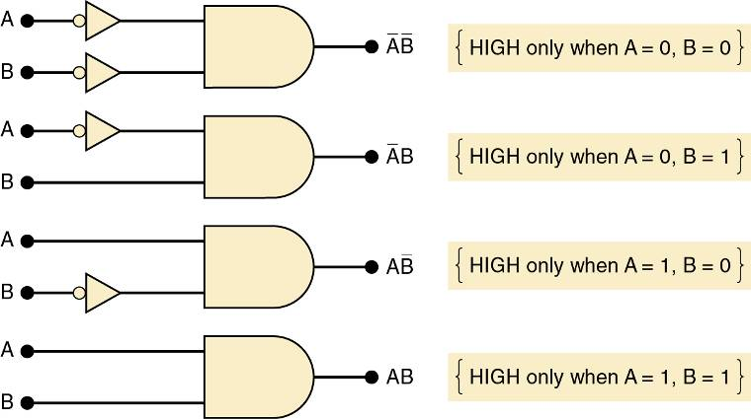
4-4 Designing Combinational Logic Circuits
An AND gate with appropriate inputs can be used to produce a HIGH output for a specific set of input levels.
Digital Systems: Principles and Applications, 11/e
Ronald J. Tocci, Neal S. Widmer, Gregory L. Moss

Slide 13
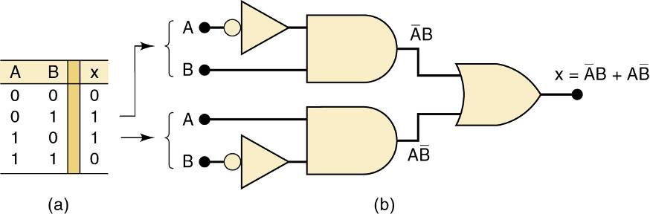
4-4 Designing Combinational Logic Circuits
Each set of input conditions that is to produce a 1 output is implemented by a separate AND gate.
The AND outputs are ORed to produce the final output.
Digital Systems: Principles and Applications, 11/e
Ronald J. Tocci, Neal S. Widmer, Gregory L. Moss

Slide 14
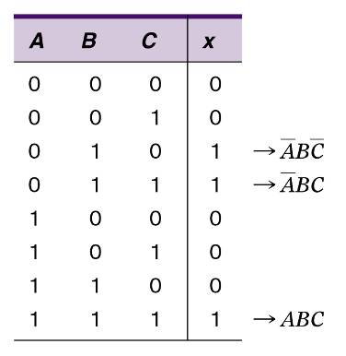
4-4 Designing Combinational Logic Circuits
Truth table for a 3-input circuit.
AND terms for each case where output is 1.
Digital Systems: Principles and Applications, 11/e
Ronald J. Tocci, Neal S. Widmer, Gregory L. Moss

Slide 15
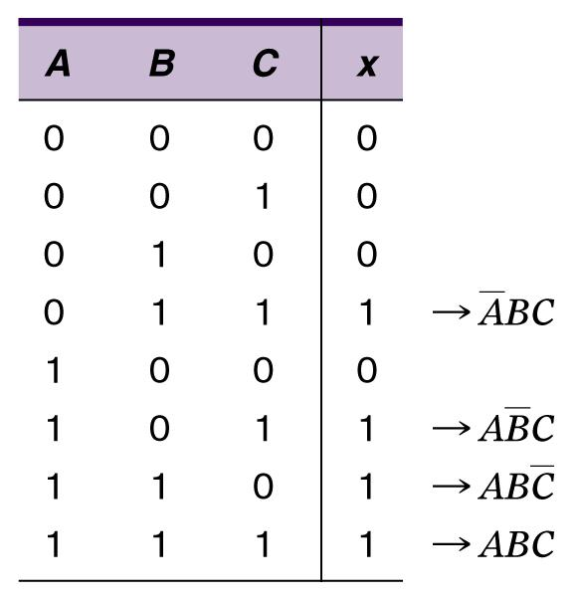
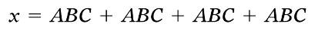
4-4 Designing Combinational Logic Circuits
Design a logic circuit with three inputs, A, B, and C. Output to be HIGH only when a majority inputs are HIGH.
AND terms for each case where output is 1.
Truth table.
SOP expression for the output:
Digital Systems: Principles and Applications, 11/e
Ronald J. Tocci, Neal S. Widmer, Gregory L. Moss

Slide 16
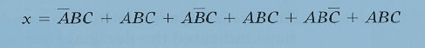
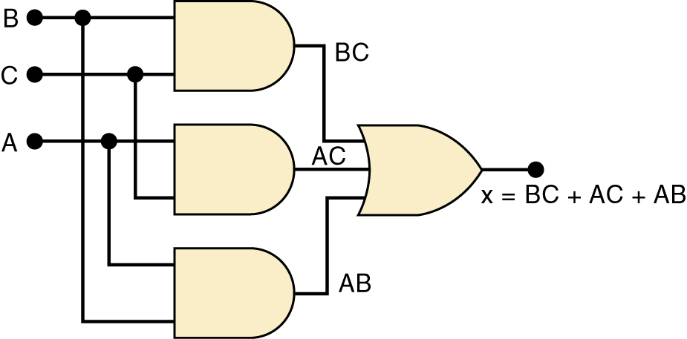
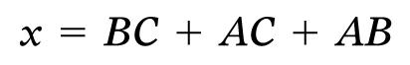
4-4 Designing Combinational Logic Circuits
Design a logic circuit with three inputs, A, B, and C. Output to be HIGH only when a majority inputs are HIGH.
Simplified output expression:
Implementing the circuit after factoring:
Since the expression is in SOP form, the circuit is a group of AND gates, working into a single OR gate,
Digital Systems: Principles and Applications, 11/e
Ronald J. Tocci, Neal S. Widmer, Gregory L. Moss

Slide 17
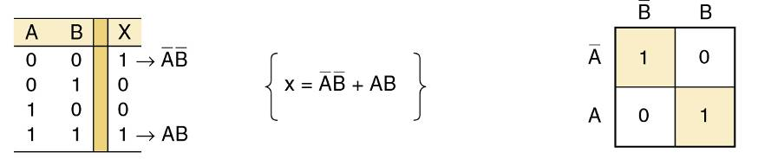
4-5 Karnaugh Map Method
A graphical method of simplifying logic equations or truth tables—also called a K map.
Theoretically can be used for any number of input variables—practically limited to 5 or 6 variables.
The truth table values are placed in the K map. Shown here is a two-variable map.
Digital Systems: Principles and Applications, 11/e
Ronald J. Tocci, Neal S. Widmer, Gregory L. Moss

Slide 18
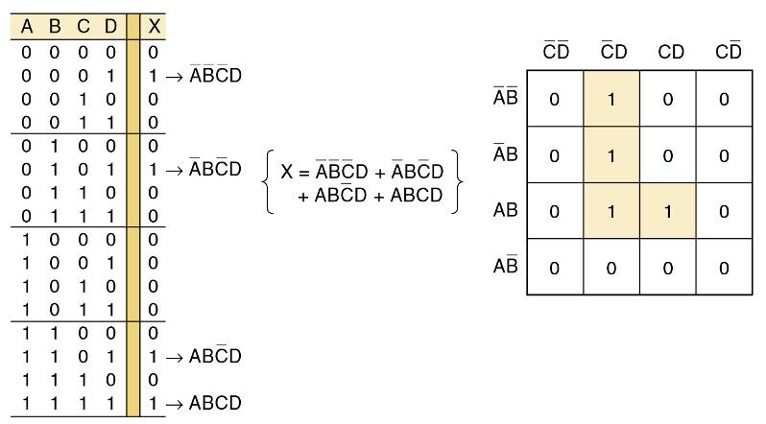
4-5 Karnaugh Map Method
Four-variable K-Map.
Adjacent K map square differ in only one variable both horizontally and vertically.
A SOP expression can be obtained by ORing all squares that contain a 1.
Digital Systems: Principles and Applications, 11/e
Ronald J. Tocci, Neal S. Widmer, Gregory L. Moss

Slide 19
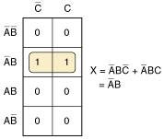
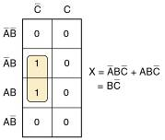
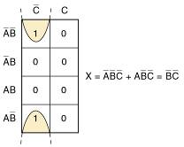
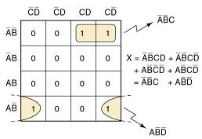
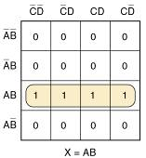
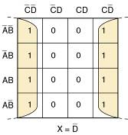
4-5 Karnaugh Map Method
Looping 1s in adjacent groups of 2, 4, or 8 will result in further simplification.
Looping groups of 2 (Pairs)
Groups of 4 (Quads)
Groups of 8 (Octets)
Digital Systems: Principles and Applications, 11/e
Ronald J. Tocci, Neal S. Widmer, Gregory L. Moss

Slide 20
4-5 Karnaugh Map Method
When the largest possible groups have been looped, only the common terms are placed in the final expression.
Looping may also be wrapped between top, bottom, and sides.
Digital Systems: Principles and Applications, 11/e
Ronald J. Tocci, Neal S. Widmer, Gregory L. Moss

Slide 21
4-5 Karnaugh Map Method
Complete K map simplification process:
Construct the K map, place 1s as indicated in the truth table.
Loop 1s that are not adjacent to any other 1s.
Loop 1s that are in pairs.
Loop 1s in octets even if they have already been looped.
Loop quads that have one or more 1s not already looped.
Loop any pairs necessary to include 1st not already looped.
Form the OR sum of terms generated by each loop.
When a variable appears in both complemented and uncomplemented form within a loop, that variable is eliminated from the expression. Variables that are the same for all squares of the loop must appear in the final expression.
Digital Systems: Principles and Applications, 11/e
Ronald J. Tocci, Neal S. Widmer, Gregory L. Moss

Slide 22
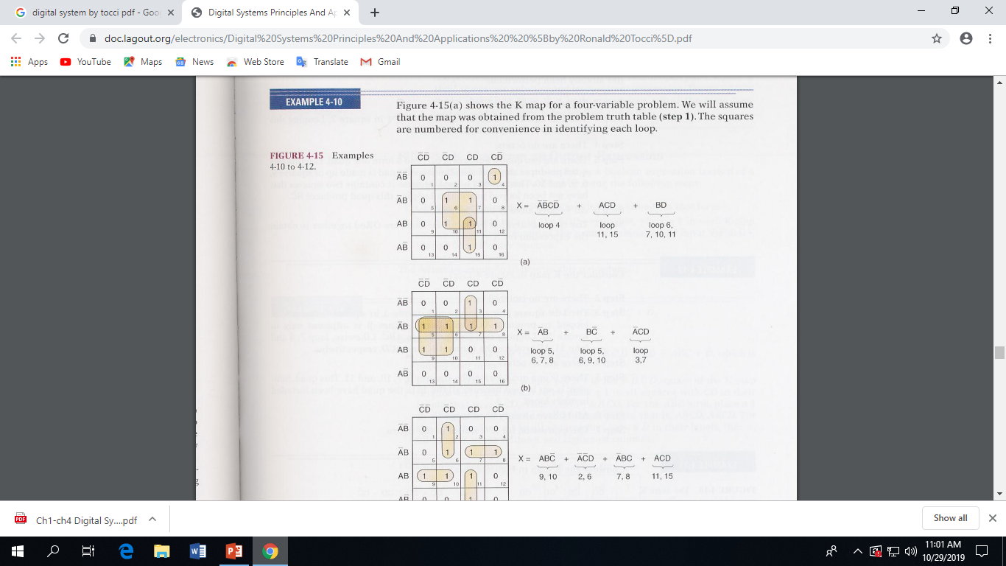

Examples of K-Map
(a)
Digital Systems: Principles and Applications, 11/e
Ronald J. Tocci, Neal S. Widmer, Gregory L. Moss

Slide 23
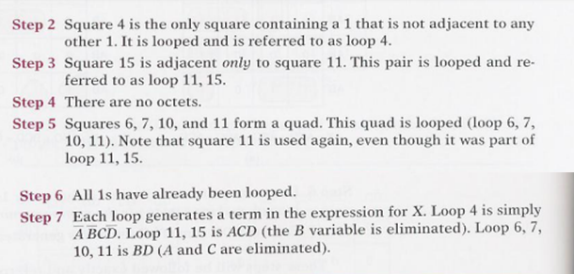
Digital Systems: Principles and Applications, 11/e
Ronald J. Tocci, Neal S. Widmer, Gregory L. Moss

Slide 24
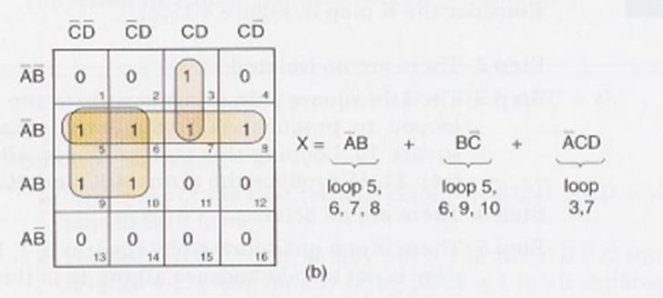
(b)
Digital Systems: Principles and Applications, 11/e
Ronald J. Tocci, Neal S. Widmer, Gregory L. Moss

Slide 25
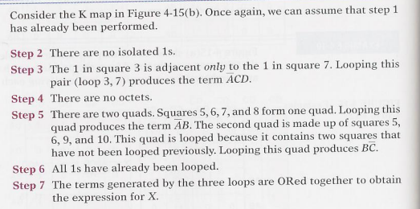
Digital Systems: Principles and Applications, 11/e
Ronald J. Tocci, Neal S. Widmer, Gregory L. Moss

Slide 26
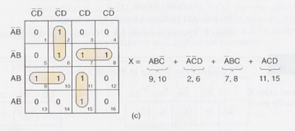
(c)
Digital Systems: Principles and Applications, 11/e
Ronald J. Tocci, Neal S. Widmer, Gregory L. Moss

Slide 27
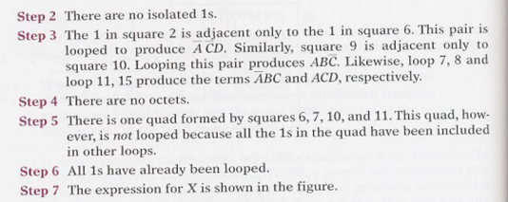
Digital Systems: Principles and Applications, 11/e
Ronald J. Tocci, Neal S. Widmer, Gregory L. Moss

Slide 28
4-6 Exclusive OR and Exclusive NOR Circuits
The exclusive OR (XOR) produces a HIGH output whenever the two inputs are at opposite levels.
Digital Systems: Principles and Applications, 11/e
Ronald J. Tocci, Neal S. Widmer, Gregory L. Moss

Slide 29
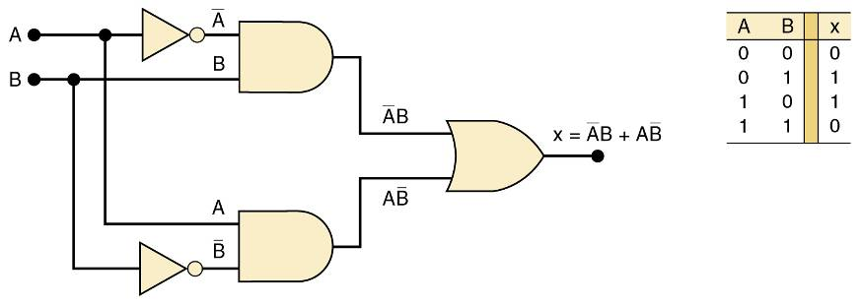
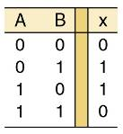
4-6 Exclusive OR and Exclusive NOR Circuits
Exclusive OR circuit and truth table.
Output expression:
x = AB + AB
This circuit produces a HIGH output whenever the two inputs are at opposite levels.
Digital Systems: Principles and Applications, 11/e
Ronald J. Tocci, Neal S. Widmer, Gregory L. Moss

Slide 30
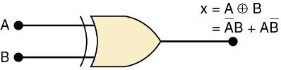
4-6 Exclusive OR and Exclusive NOR Circuits
Traditional XOR gate symbol.
An XOR gate has only two inputs, combined so that x = AB + AB.
A shorthand way indicate the XOR output expression is:
x = A B.
…where the symbol represents the XOR gate operation.
Output is HIGH only when the two inputs are at different levels.
Quad XOR chips containing four XOR gates.
74LS86 Quad XOR (TTL family)
74C86 Quad XOR (CMOS family)
74HC86 Quad XOR (high-speed CMOS)
Digital Systems: Principles and Applications, 11/e
Ronald J. Tocci, Neal S. Widmer, Gregory L. Moss

Slide 31
4-6 Exclusive OR and Exclusive NOR Circuits
The exclusive NOR (XOR) produces a HIGH output whenever the two inputs are at the same level.
XOR and XNOR outputs are opposite.
Digital Systems: Principles and Applications, 11/e
Ronald J. Tocci, Neal S. Widmer, Gregory L. Moss

Slide 32
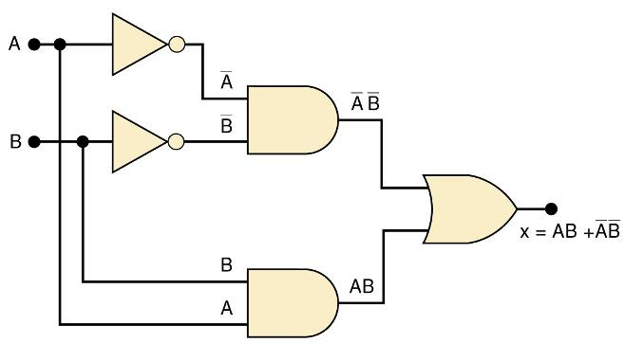
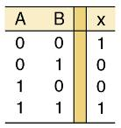
4-6 Exclusive OR and Exclusive NOR Circuits
Exclusive NOR circuit and truth table.
Output expression:
x = AB + AB
XNOR produces a HIGH output whenever the two inputs are at the same levels.
Digital Systems: Principles and Applications, 11/e
Ronald J. Tocci, Neal S. Widmer, Gregory L. Moss

Slide 33
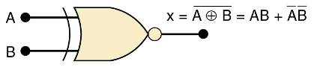
4-6 Exclusive OR and Exclusive NOR Circuits
Traditional XNOR gate symbol.
An XNOR gate has only two inputs, combined so that x = AB + AB.
A shorthand way indicate the XOR output expression is:
x = A B.
XNOR represents inverse of the XOR operation.
Output is HIGH only when the two inputs are at the same level.
Quad XNOR chips with four XNOR gates.
74LS266 Quad XNOR (TTL family)
74C266 Quad XOR (CMOS)
74HC266 Quad XOR (high-speed CMOS)
Digital Systems: Principles and Applications, 11/e
Ronald J. Tocci, Neal S. Widmer, Gregory L. Moss

Slide 34
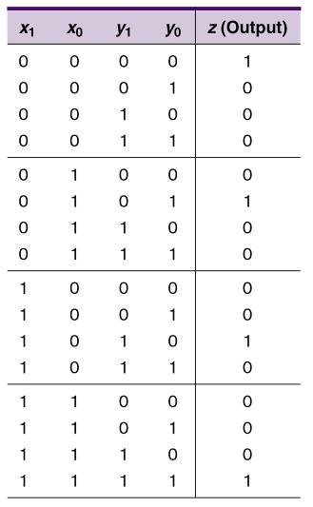
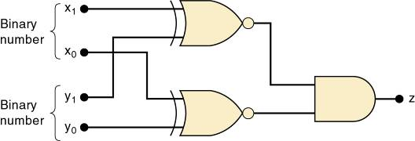
4-6 Exclusive OR and Exclusive NOR Circuits
Truth table and circuit for detecting equality of two-bit binary numbers.
Digital Systems: Principles and Applications, 11/e
Ronald J. Tocci, Neal S. Widmer, Gregory L. Moss

Slide 35
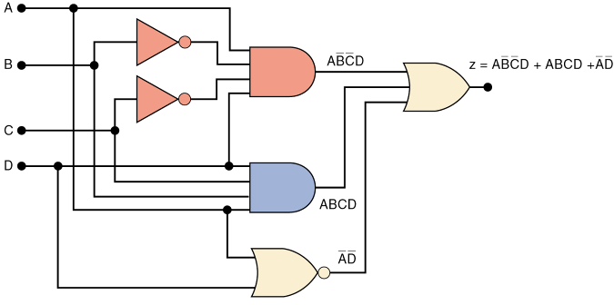
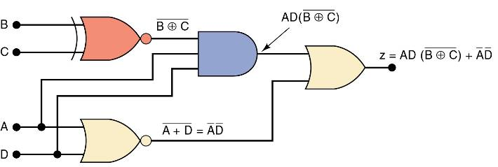
4-6 Exclusive OR and Exclusive NOR Circuits
How an XNOR gate may be used to simplify circuit implementation.
Digital Systems: Principles and Applications, 11/e
Ronald J. Tocci, Neal S. Widmer, Gregory L. Moss

Slide 36
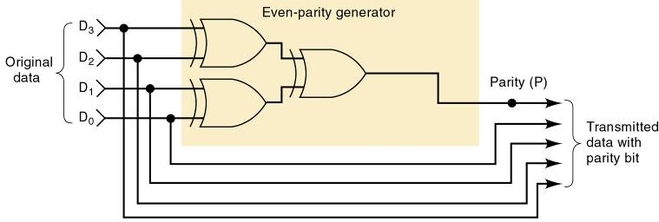
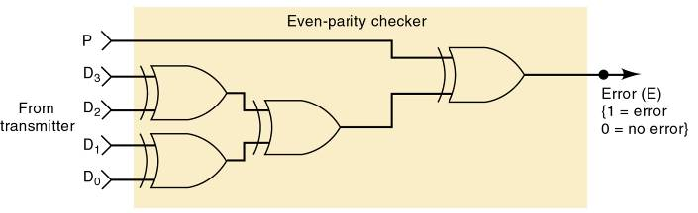
4-7 Parity Generator and Checker
XOR and XNOR gates are useful in circuits for parity generation and checking.
Digital Systems: Principles and Applications, 11/e
Ronald J. Tocci, Neal S. Widmer, Gregory L. Moss

Slide 37
4-8 Enable/Disable Circuits
Situations requiring enable/disable circuits occur frequently in digital circuit design.
A circuit is enabled when it allows the passage of an input signal to the output.
A circuit is disabled when it prevents the passage of an input signal to the output.
Digital Systems: Principles and Applications, 11/e
Ronald J. Tocci, Neal S. Widmer, Gregory L. Moss

Slide 38
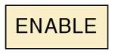

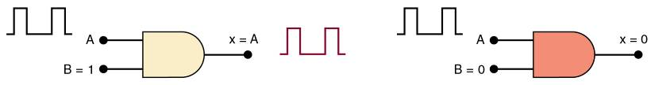
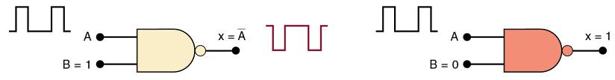
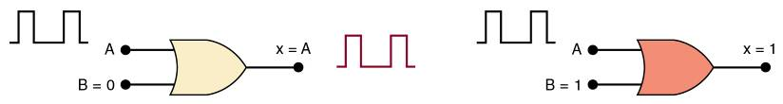
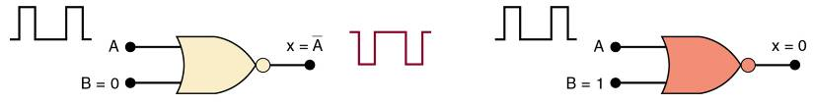
4-8 Enable/Disable Circuits
Digital Systems: Principles and Applications, 11/e
Ronald J. Tocci, Neal S. Widmer, Gregory L. Moss

Slide 39
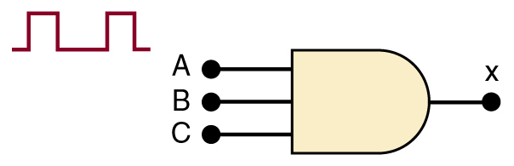
4-8 Enable/Disable Circuits
A logic circuit that will allow a signal to pass to output only when control inputs B and C are both HIGH.
Otherwise, output will stay LOW.
Digital Systems: Principles and Applications, 11/e
Ronald J. Tocci, Neal S. Widmer, Gregory L. Moss

Slide 40
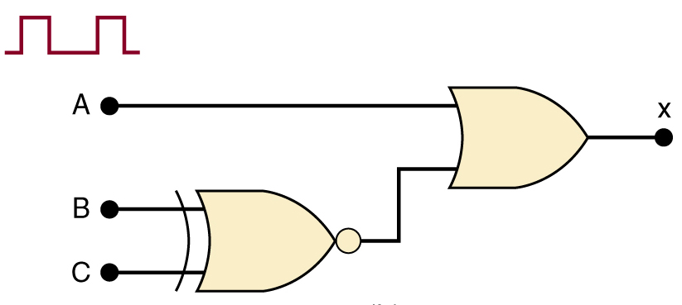
4-8 Enable/Disable Circuits
A logic circuit that will allow a signal to pass to output only when one, but not both control inputs are HIGH.
Otherwise, output will stay HIGH.
Digital Systems: Principles and Applications, 11/e
Ronald J. Tocci, Neal S. Widmer, Gregory L. Moss

Slide 41

4-8 Enable/Disable Circuits
A logic circuit with input signal A, control input B, and outputs X and Y, which operates as:
When B = 1, output X will follow input A, and output Y will be 0.
When B = 0, output X will be 0, and output Y will follow input A.
Digital Systems: Principles and Applications, 11/e
Ronald J. Tocci, Neal S. Widmer, Gregory L. Moss

Slide 42

4-9 Basic Characteristics of Digital ICs
IC “chips” consist of resistors, diodes & transistors fabricated on a piece of semiconductor material called a substrate.
Digital ICs are often categorized by complexity, according to the number of logic gates on the substrate.
Digital Systems: Principles and Applications, 11/e
Ronald J. Tocci, Neal S. Widmer, Gregory L. Moss

Slide 43

4-9 Basic Characteristics of Digital ICs
The dual-in-line package (DIP) contains two parallel rows of pins.
The DIP is probably the most common digital IC package found in older
digital equipment.
Digital Systems: Principles and Applications, 11/e
Ronald J. Tocci, Neal S. Widmer, Gregory L. Moss

Slide 44

4-9 Basic Characteristics of Digital ICs
Pins are numbered counterclockwise, viewed from the top of the package, with respect to an identifying notch or dot at one end.
Shown is a 14-pin DIP that measures .75” x .25”.
Digital Systems: Principles and Applications, 11/e
Ronald J. Tocci, Neal S. Widmer, Gregory L. Moss

Slide 45

4-9 Basic Characteristics of Digital ICs
The actual silicon chip is much smaller than the DIP—typically about 0.05” square.
The silicon chip is connected to the pins of the DIP by very fine (1- mil) wires.
Digital Systems: Principles and Applications, 11/e
Ronald J. Tocci, Neal S. Widmer, Gregory L. Moss

Slide 46

4-9 Basic Characteristics of Digital ICs
The PLCC is one of many packages common in modern digital circuits.
This type uses J-shaped leads which curl under the IC.
Digital Systems: Principles and Applications, 11/e
Ronald J. Tocci, Neal S. Widmer, Gregory L. Moss

Slide 47
4-9 Basic Characteristics of Digital ICs
ICs are also categorized by the type of components used in their circuits.
Bipolar ICs use NPN and PNP transistors
Unipolar ICs use FET transistors.
Digital Systems: Principles and Applications, 11/e
Ronald J. Tocci, Neal S. Widmer, Gregory L. Moss

Slide 48

4-9 Basic Characteristics of Digital ICs
The transistor-transistor logic (TTL) family consists of subfamilies shown here:
Differences between the TTL devices is limited to electrical characteristics such as power dissipation & switching speed. Pin layout and logic operations are the same.
Digital Systems: Principles and Applications, 11/e
Ronald J. Tocci, Neal S. Widmer, Gregory L. Moss

Slide 49

4-9 Basic Characteristics of Digital ICs
V_{CC} for TTL devices is normally +5 V.
Power (V_{CC}) and ground connections are required for chip operation.
TTL INVERTER
Digital Systems: Principles and Applications, 11/e
Ronald J. Tocci, Neal S. Widmer, Gregory L. Moss

Slide 50

4-9 Basic Characteristics of Digital ICs
The Complimentary Metal-Oxide Semiconductor (CMOS) family consists of several series
CMOS devices perform the same function as, but are not necessarily pin for pin compatible with TTL devices.
Digital Systems: Principles and Applications, 11/e
Ronald J. Tocci, Neal S. Widmer, Gregory L. Moss

Slide 51

4-9 Basic Characteristics of Digital ICs
V_{DD} for CMOS devices can be from +3 to +18 V.
Power (V_{DD}) and ground connections are required for chip operation.
CMOS INVERTER
Digital Systems: Principles and Applications, 11/e
Ronald J. Tocci, Neal S. Widmer, Gregory L. Moss

Slide 52
4-9 Basic Characteristics of Digital ICs
Inputs not connected are said to be floating.
Floating TTL input acts like a logic 1.
Voltage measurement may appear indeterminate, but the device behaves as if there is a 1 on the floating input
Floating CMOS inputs can cause overheating and damage to the device.
Some ICs have protection circuits built in.
The best practice is to tie all unused inputs.
Either high or low.
Digital Systems: Principles and Applications, 11/e
Ronald J. Tocci, Neal S. Widmer, Gregory L. Moss

Slide 53

4-9 Basic Characteristics of Digital ICs
Voltages in the indeterminate range provide unpredictable results and should be avoided.
Logic levels for TTL and CMOS devices.
Digital Systems: Principles and Applications, 11/e
Ronald J. Tocci, Neal S. Widmer, Gregory L. Moss

Slide 54


4-9 Basic Characteristics of Digital ICs
A connection diagram shows all electrical connections, pin numbers, IC numbers, component values, signal names, and power supply voltages.
This circuit uses logic gates from two different ICs.
Each gate input & output pin number is indicated on the diagram, to easily reference any point in the circuit.
Power/ ground connections to each IC are shown.
Digital Systems: Principles and Applications, 11/e
Ronald J. Tocci, Neal S. Widmer, Gregory L. Moss

Slide 55

4-9 Basic Characteristics of Digital ICs
Logic diagram using Quartus II schematic capture.
Digital Systems: Principles and Applications, 11/e
Ronald J. Tocci, Neal S. Widmer, Gregory L. Moss

Slide 56
4-10 Troubleshooting Digital Systems
Three basic steps in fixing a digital circuit or system that has a fault (failure):
Fault detection—determine operation to expected operation.
Fault isolation—test & measure to isolate the fault.
Fault correction—repair the fault.
The basic troubleshooting tools are the logic probe, oscilloscope, and logic pulser.
Digital Systems: Principles and Applications, 11/e
Ronald J. Tocci, Neal S. Widmer, Gregory L. Moss

Slide 57

4-10 Troubleshooting Digital Systems
The logic probe will indicate the presence or absence of a signal when touched to a pin as indicated below.
Digital Systems: Principles and Applications, 11/e
Ronald J. Tocci, Neal S. Widmer, Gregory L. Moss

Slide 58
4-11 Internal Digital IC Faults
Most common internal failures:
Malfunction in the internal circuitry.
Outputs do not respond properly to inputs.
Outputs are unpredictable.
Inputs or outputs shorted to ground or V_{CC} .
The input will be stuck in LOW or HIGH state.
Inputs or outputs open-circuited .
An open output will result in a floating indication.
Floating input in a TTL will result in a HIGH output.
Floating input in a CMOS device will result in erratic or possibly destructive output.
Short between two pins (other than ground or V_{CC}).
The signal at those pins will always be identical.
Digital Systems: Principles and Applications, 11/e
Ronald J. Tocci, Neal S. Widmer, Gregory L. Moss

Slide 59

4-11 Internal Digital IC Faults
These two types of failures force the input signal at the shorted pin to stay in the same state.
Left—IC input internally shorted to ground.
Right—IC input internally shorted to supply voltage.
Digital Systems: Principles and Applications, 11/e
Ronald J. Tocci, Neal S. Widmer, Gregory L. Moss

Slide 60

4-11 Internal Digital IC Faults
These two types of failures do not affect signals at the IC inputs.
Left—IC output internally shorted to ground.
Right—IC output internally shorted to supply voltage.
Digital Systems: Principles and Applications, 11/e
Ronald J. Tocci, Neal S. Widmer, Gregory L. Moss

Slide 61

4-11 Internal Digital IC Faults
An IC with an internally open input will not respond to signals applied to that input pin.
An internally open output will produce an unpredictable voltage at that output pin.
Digital Systems: Principles and Applications, 11/e
Ronald J. Tocci, Neal S. Widmer, Gregory L. Moss

Slide 62

4-11 Internal Digital IC Faults
An internal short between two pins of an IC will force the logic signals at those pins always to be identical.
When two input pins are internally shorted, the signals driving these pins are forced to be identical, and usually a signal with three distinct levels results.
Digital Systems: Principles and Applications, 11/e
Ronald J. Tocci, Neal S. Widmer, Gregory L. Moss

Slide 63
4-12 External Faults
Open signal lines—signal prevented from moving between points—can be caused by:
Broken wire.
Poor connections (solder or wire-wrap).
Cut or crack on PC board trace.
Bent or broken IC pins.
Faulty IC socket.
This type of fault can be detected visually and verified with an ohmmeter between the points in question.
Digital Systems: Principles and Applications, 11/e
Ronald J. Tocci, Neal S. Widmer, Gregory L. Moss

Slide 64

4-12 External Faults
What is the most probable fault in the circuit shown?
The indeterminate level at the NOR gate output is probably due to the indeterminate input at pin 2.
Because there is a LOW at Z1-6, this LOW should also be at Z2-2.
Digital Systems: Principles and Applications, 11/e
Ronald J. Tocci, Neal S. Widmer, Gregory L. Moss

Slide 65
4-12 External Faults
Shorted signal lines—the same signal appears on two or more pins—and V_{CC} or ground may also be shorted, caused by:
Sloppy wiring.
Solder bridges.
Incomplete etching.
This type of fault can be detected visually and verified with an ohmmeter between the points in question.
Digital Systems: Principles and Applications, 11/e
Ronald J. Tocci, Neal S. Widmer, Gregory L. Moss

Slide 66
4-12 External Faults
Faulty power supply—ICs will not operate or will operate erratically.
May lose regulation due to an internal fault or because circuits are drawing too much current.
Verify that power supplies provide the specified range of voltages and are properly grounded.
Use an oscilloscope to verify that AC ripple is not present and verify that DC voltages stay regulated.
Some ICs are more tolerant of power variations and may operate properly—others do not.
Check power and ground levels at each IC that appears to be operating incorrectly.
Digital Systems: Principles and Applications, 11/e
Ronald J. Tocci, Neal S. Widmer, Gregory L. Moss

Slide 67
4-12 External Faults
Output loading—caused by connecting too many inputs to the output of an IC, exceeding output current rating.
Output voltage falls into the indeterminate range.
Called loading the output signal.
Usually a result of poor design or bad connection.
Digital Systems: Principles and Applications, 11/e
Ronald J. Tocci, Neal S. Widmer, Gregory L. Moss

Slide 68
4-14 Programmable Logic Devices
The concept behind programmable logic devices is simple—lots of logic gates in a single IC.
Control of the interconnection of these gates electronically.
PLDs allow the design process to be automated.
Designers identify inputs, outputs, and logical relationships.
PLDs are electronically configured to form the defined logic circuits.
Digital Systems: Principles and Applications, 11/e
Ronald J. Tocci, Neal S. Widmer, Gregory L. Moss

Slide 69

4-14 Programmable Logic Devices
PLDs use a switch matrix that is often referred to as a programmable array.
By deciding which intersections are connected & which are not, we can “program” the way the inputs are connected to the outputs of the array.
Digital Systems: Principles and Applications, 11/e
Ronald J. Tocci, Neal S. Widmer, Gregory L. Moss

Slide 70

4-14 Programmable Logic Devices
For out-of-system programming the PLD is placed in a programmer, connected to a PC.
PC software translates and loads the information.
Digital Systems: Principles and Applications, 11/e
Ronald J. Tocci, Neal S. Widmer, Gregory L. Moss

Slide 71
4-14 Programmable Logic Devices
In-system programming is done by connecting directly to “portal” pins while the IC remains in the system.
An interface cable connects the PLD to a PC running the software that loads the device.
Digital Systems: Principles and Applications, 11/e
Ronald J. Tocci, Neal S. Widmer, Gregory L. Moss

Slide 72
4-14 Programmable Logic Devices
Logic circuits can be described using schematic diagrams, logic equations, truth tables, and HDL.
PLD development software can convert any of these descriptions into 1s and 0s and loaded into the PLD.
Altera MAX+PLUS II is a development software that allows the user to describe circuits using graphic design files and timing diagrams.
Digital Systems: Principles and Applications, 11/e
Ronald J. Tocci, Neal S. Widmer, Gregory L. Moss

Slide 73

4-14 Programmable Logic Devices
Hierarchical design—small logic circuits are defined and combined with other circuits to form a large section of a project.
Large sections can be combined and connected for form a system.
Combining blocks developed using different description
methods.
Digital Systems: Principles and Applications, 11/e
Ronald J. Tocci, Neal S. Widmer, Gregory L. Moss

Slide 74

4-14 Programmable Logic Devices
Top-down design—requires the definition of subsections that will make up the system.
And definition of the individual circuits that will make up each sub section.
Each level can be designed and tested individually.
Digital Systems: Principles and Applications, 11/e
Ronald J. Tocci, Neal S. Widmer, Gregory L. Moss

Slide 75

4-14 Programmable Logic Devices
Timing simulation of a circuit described in HDL.
Digital Systems: Principles and Applications, 11/e
Ronald J. Tocci, Neal S. Widmer, Gregory L. Moss

Slide 76

4-14 Programmable Logic Devices
A system is built from that bottom up.
Each block is described by a design file.
After testing it is compiled using development software.
The compiled block is tested using a simulator for verify correct operation.
A PLD is programmed to verify correct operation.
Digital Systems: Principles and Applications, 11/e
Ronald J. Tocci, Neal S. Widmer, Gregory L. Moss

Slide 77

4-15 Representing Data in HDL
Every programming language & HDL has its own unique way of identifying number systems.
Generally done with a prefix to indicate the system.
When we read one of these number designations, we must think of it as a symbol that represents a binary bit pattern.
These numeric values are referred to as scalars or literals.
Digital Systems: Principles and Applications, 11/e
Ronald J. Tocci, Neal S. Widmer, Gregory L. Moss

Slide 78

4-15 Representing Data in HDL
In order to describe a port with more than one data bit we assign a name and the number of bits.
This is called a bit array or bit vector.
Each element (bit) has a unique index number (0–7) to describe position in the overall structure.
HDLs & computer programming languages use this notation.
Digital Systems: Principles and Applications, 11/e
Ronald J. Tocci, Neal S. Widmer, Gregory L. Moss

Slide 79
4-15 Representing Data in HDL – AHDL Syntax
AHDL syntax—a name for the bit vector is followed by the range of index designations.
Inside square brackets, in the SUBDESIGN section.
To declare an eight-bit input port called p1…
p1[7..0] :INPUT; --define an 8-bit input port
Digital Systems: Principles and Applications, 11/e
Ronald J. Tocci, Neal S. Widmer, Gregory L. Moss

Slide 80
4-15 Representing Data in HDL – AHDL Syntax
Intermediate variables can be declared as an array of bits.
Eight-bit temperature port p1 assigned to a node named temp…
VARIABLE temp[7..0] :NODE;
BEGIN
temp[] = p1[]
END;
The empty braces mean that all bits in the array are being connected. Individual bits could be connected by specifying the bits inside the braces.
Digital Systems: Principles and Applications, 11/e
Ronald J. Tocci, Neal S. Widmer, Gregory L. Moss

Slide 81
4-15 Representing Data in HDL – VHDL Syntax
VHDL syntax—a name for the bit vector is followed by the mode, the type, and the range.
Enclosed in parenthesis, in the ENTITY section.
To declare an eight-bit input port called p1…
PORT (p1 :IN BIT_VECTOR (7 DOWNTO 0);
Digital Systems: Principles and Applications, 11/e
Ronald J. Tocci, Neal S. Widmer, Gregory L. Moss

Slide 82
4-15 Representing Data in HDL – VHDL Syntax
Intermediate variables can be declared as an array of bits—in the ARCHITECTURE section
Eight-bit temperature port p1 assigned to a signal named temp…
SIGNAL temp :BIT_VECTOR {7 DOWNTO 0}; BEGIN
temp <= p1;
END;
When no elements in the bit vector are specified, all bits in the array are being connected. Individual bits could be connected by specifying bit numbers inside the parentheses.
Digital Systems: Principles and Applications, 11/e
Ronald J. Tocci, Neal S. Widmer, Gregory L. Moss

Slide 83

4-15 Representing Data in HDL
VHDL offers some standardized data types in libraries—collections of VHDL code that can be used to avoid reinventing the wheel.
Many convenient functions such as standard TTL device descriptions are contained in macrofunctions.
Digital Systems: Principles and Applications, 11/e
Ronald J. Tocci, Neal S. Widmer, Gregory L. Moss

Slide 84


4-16 Truth Tables Using HDL - AHDL
Circuits can be designed directly from truth tables, using AHDL and VHDL.
Digital Systems: Principles and Applications, 11/e
Ronald J. Tocci, Neal S. Widmer, Gregory L. Moss

Slide 85

4-16 Truth Tables Using HDL - VHDL
Circuits can be designed directly from truth tables, using AHDL and VHDL.
Digital Systems: Principles and Applications, 11/e
Ronald J. Tocci, Neal S. Widmer, Gregory L. Moss

Slide 86

4-17 Decision Control Structures in HDL – IF/THEN/ELSE
IF/THEN/ELSE statements provide a framework for making logical decisions in a system
IF/THEN is used when there is a choice between doing something and doing nothing.
Digital Systems: Principles and Applications, 11/e
Ronald J. Tocci, Neal S. Widmer, Gregory L. Moss

Slide 87

4-17 Decision Control Structures in HDL – IF/THEN/ELSE
IF/THEN/ELSE statements provide a framework for making logical decisions in a system
IF/THEN/ELSE is used when there is a choice of two possible actions.
Digital Systems: Principles and Applications, 11/e
Ronald J. Tocci, Neal S. Widmer, Gregory L. Moss

Slide 88

4-17 Decision Control Structures in HDL – IF/THEN/ELSE
IF/THEN/ELSE in AHDL:
Digital Systems: Principles and Applications, 11/e
Ronald J. Tocci, Neal S. Widmer, Gregory L. Moss

Slide 89

4-17 Decision Control Structures in HDL – IF/THEN/ELSE
IF/THEN/ELSE in VHDL:
Digital Systems: Principles and Applications, 11/e
Ronald J. Tocci, Neal S. Widmer, Gregory L. Moss

Slide 90

4-17 Decision Control Structures in HDL – ELSIF
By combining IF and ELSE decisions, we can create a control structure referred to as ELSIF
Which chooses one of many possible outcomes.
As each condition is evaluated, it performs an action—if true— or goes on to evaluate the next condition.
Digital Systems: Principles and Applications, 11/e
Ronald J. Tocci, Neal S. Widmer, Gregory L. Moss

Slide 91


4-17 Decision Control Structures in HDL – ELSIF
A temperature measuring system using an A/D converter.
IF the digital value is less than or equal to 8… THEN light only the Too Cold indicator.
ELSE IF the digital value is greater than 8 AND less than 11… THEN light only the Just Right indicator.
ELSE light only the Too Hot indicator.
Digital Systems: Principles and Applications, 11/e
Ronald J. Tocci, Neal S. Widmer, Gregory L. Moss

Slide 92

4-17 Decision Control Structures in HDL – ELSIF
ELSIF in AHDL:
Digital Systems: Principles and Applications, 11/e
Ronald J. Tocci, Neal S. Widmer, Gregory L. Moss

Slide 93

4-17 Decision Control Structures in HDL – ELSIF
ELSIF in VHDL:
Digital Systems: Principles and Applications, 11/e
Ronald J. Tocci, Neal S. Widmer, Gregory L. Moss

Slide 94
4-17 Decision Control Structures in HDL - CASE
The CASE construct determines the value of an expression or object.
Then goes through a list of values (cases) to determine what action to take.
Different than the IF/ELSEIF, as there is only one action or match for a case statement.
Digital Systems: Principles and Applications, 11/e
Ronald J. Tocci, Neal S. Widmer, Gregory L. Moss

Slide 95

4-17 Decision Control Structures in HDL - CASE
CASE construct in AHDL:
Digital Systems: Principles and Applications, 11/e
Ronald J. Tocci, Neal S. Widmer, Gregory L. Moss

Slide 96

4-17 Decision Control Structures in HDL - CASE
CASE construct in VHDL:
Digital Systems: Principles and Applications, 11/e
Ronald J. Tocci, Neal S. Widmer, Gregory L. Moss

Slide 97





4-17 Decision Control Structures in HDL - CASE
A vending machine coin detector accepts quarters, dimes & nickels, activating the corresponding digital signal (Q, D, N) only when the correct coin is present.
A digital circuit must use the Q, D, and N, signals as inputs and produce a binary number that represents the value of the coin
Digital Systems: Principles and Applications, 11/e
Ronald J. Tocci, Neal S. Widmer, Gregory L. Moss

Slide 98

4-17 Decision Control Structures in HDL - CASE
The coin detector in AHDL:
Digital Systems: Principles and Applications, 11/e
Ronald J. Tocci, Neal S. Widmer, Gregory L. Moss

Slide 99

4-17 Decision Control Structures in HDL - CASE
The coin detector in VHDL:
Digital Systems: Principles and Applications, 11/e
Ronald J. Tocci, Neal S. Widmer, Gregory L. Moss

Slide 100
END

